Slide 1
Information Story:
IMT 542 Assignment G4 Updated
Em Stelter, 6/5/2026

Slide 2
1) Description of information system
Description of information system product:
Archive of Our Own, or Ao3, is an online archive of fanfiction (i.e. stories or other kinds of art about / set in a preexisting intellectual property, written by fans for free, purely for the love of the game) and other transformative works. Fanfiction as a writing genre, particularly as stored on Ao3, differs from traditional fiction in that stories are heavily tagged with metadata that flags information about the story up front, including certain types of character relationships, content warnings, ratings, among other things.
The product is a Python-based tool (set of Jupyter notebooks & Python scripts) that:
Scrapes metadata from published works on the fanfiction archive website Archive of Our Own (Ao3)
Converts the compiled metadata into a JSON array of metadata for all works listed under a particular fandom or intellectual property on Ao3
Converts the JSON array into a dataframe
Create data visualizations to support insights about the collection of fanworks represented
The product will be adaptable to any fandom / particular intellectual property with a fandom presence on Archive of Our Own.
Comparison to existing systems:
Currently, there is one particular Ao3 user, toastystats, who reports on fandom metadata statistics (and provides tutorials of downloading fandom metadata directly from Ao3), but these reports not presented in an interactive dashboard. I would be writing a developing a program/process that would allow for scraping fandom metadata and then converting it to a more portable format for the purpose of data visualization and analysis.
Relevant links:
https://archiveofourown.org/works/27804601/chapters/122214766
https://archiveofourown.org/works/62863873

Slide 3
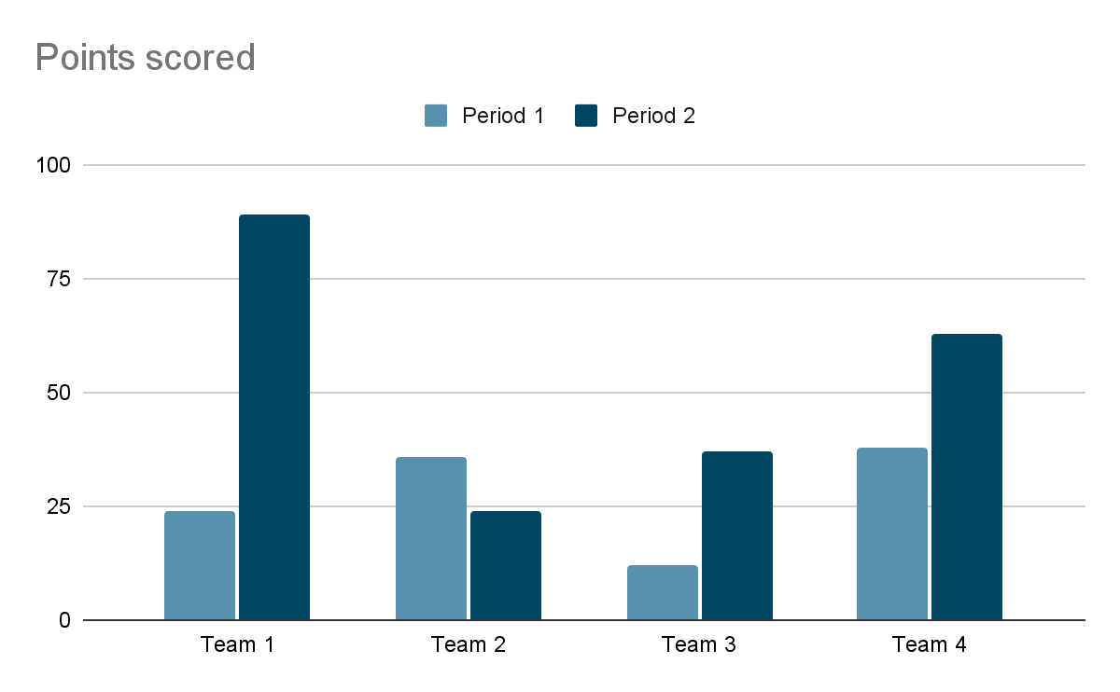
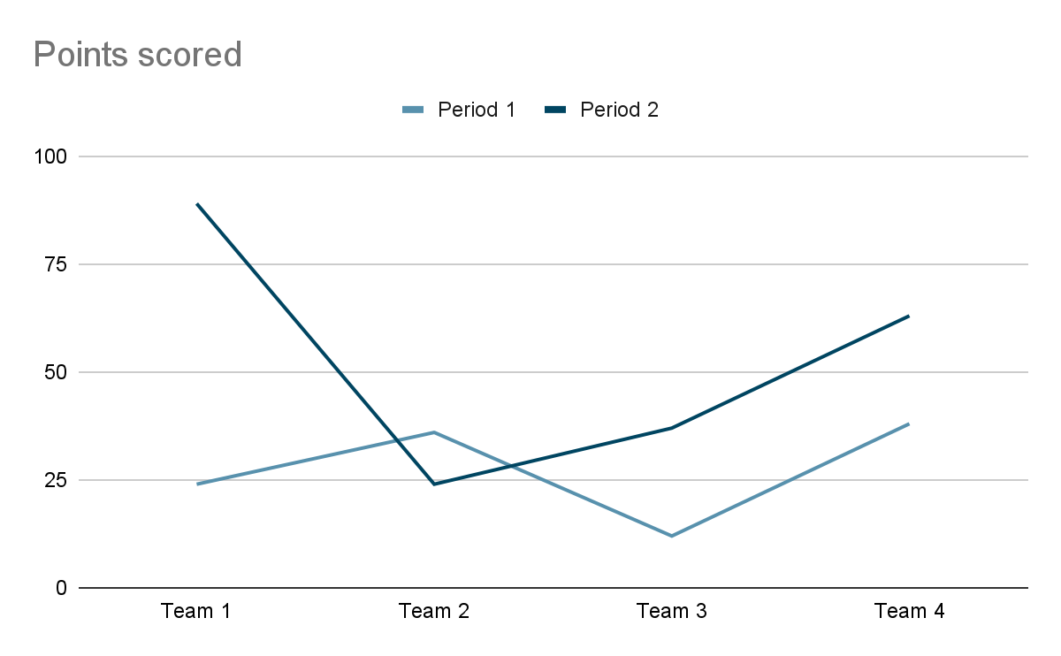
2) Information Wireframes
I created a version of this very low-fidelity wireframe when the project scope included building a streamlit-based data dashboard. This goal proved too ambitious for the scope of the quarter, but the visualizations themselves are still wireframes of information product’s end use goal.
Candela Obscura Fandom Visualizations
Notes:
Slide 2*: information wireframes (blueprint of how information is organization and/or UI wireframes that suggest how information is organized)

Slide 4
3) Description of Main Concepts
Content Metadata:
Fandom - the specific intellectual property that the fanworks are based on
Rating - analogous to film ratings, goes from G (General Audiences) to E (Explicit)
Archive Warning - sensitive content warnings for things like Major Character Death, Graphic Violence, etc.
Category - indicates gender dynamic & nature of relationships between characters (romantic, platonic, etc.)
Relationship(s) - tags for relationships between specific characters (e.g. “Sherlock Holmes / John Watson”)
Freeform / Additional Tags - any freeform tags that do not come from an Ao3 controlled list
Publication Stats:
Date Published - date the fanwork was published
# Chapters - the number of chapters published vs. the number of chapters planned (e.g. “1/1” indicates one chapter planned, one chapter published, implying that the work is complete)
Date Updated - date the fanwork was most recently updated (i.e. if the work has multiple chapters or if the author has made edits down the line)
Word Count - the number of words in the fanwork (note - Ao3 is primarily, though not exclusively, a repository for fanfiction / written fanworks)
Indicator Stats for Reader Interest & Engagement:
Kudos - akin to “likes” on other social media
Comments - specific reader feedback beyond kudos - indicates reader interest and engagement
Bookmarks - whether other Ao3 account holders have saved / bookmarked the work in their account to return and reread later
Hits - number of clicks on the fanwork’s URI / visits to the fanwork’s webpage
Notes:
Slide 3*: description of main concepts that ideally will be in the information product as either controlled vocab list or metadata scheme/taxonomy

Slide 5
4) Basic System Architecture
Identifying basic architecture for system (hosting, information structure, technologies) as best as you can today
Technologies:
For web scraping: selenium and BeautifulSoup Python libraries
For text processing & compiling metadata values into JSON structure: JSON and RegEx python libraries
For data cleaning & visualization: pandas & plotly.express Python libraries
Hosting:
Public Github repository; interested users may fork the repository to adapt the code for their own Ao3 meta analysis purposes
Interactive sample visualizations are saved as .html files for immediate interactive viewing
Documentation:
Github ReadMe describes project scope & purpose, contents of Jupyter notebooks & Python scripts, and process used for creating sample visualizations
Additional artifacts adapted from IMT 542 class assignments (including this one!)

